Slide 1

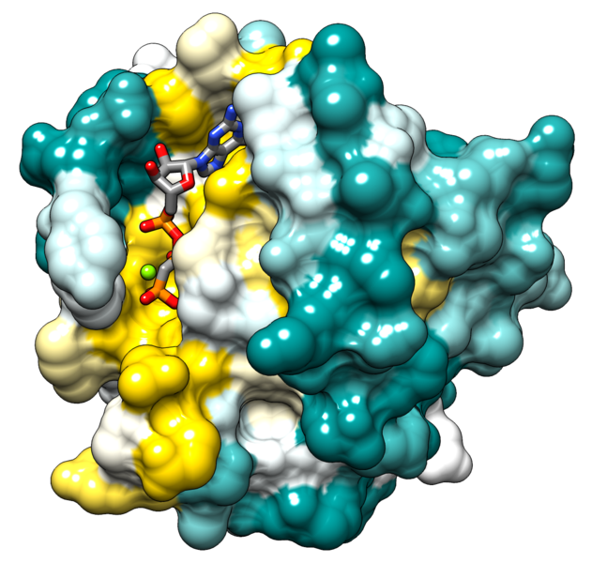
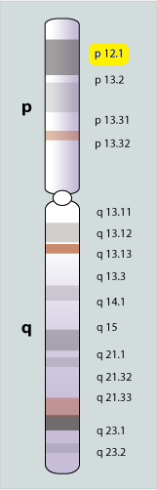
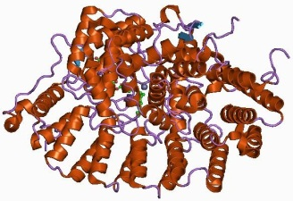
KRAS Gene in Human Genome
Assignment in Biology, ITMB
Aidonopoulos Orfeas
Begetis Nikolaos
Konstantopoulos Dimitrios
Supervisor: Anastasiadou Ema, Investigator (Lecturer Level), BRFAA

Slide 2
Abstract
At first our team is going to provide some useful information about RAS and KRAS gene family.
Focus on KRAS gene:
Separation of KRAS gene in sections
Initiation with KRAS promoters and isoforms
Continue with Isoforms and Conserved Regions
KRAS phylogenetic Tree
Continue with KRAS proteins
End with KRAS Transcription Factors and
miRNAs
Keywords: RAS family, KRAS, GTPase protein, human-oncogene, cell signaling

Slide 3
What to Learn in This Presentation
The meaning of “gene” and what can one learn given only the genes name
RAS and KRAS functionality and clinical significance
The meaning of a “promoter”
The meaning of an “isoform”
The meaning of an “conserved region”
What is a phylogenetic tree and their categories
The proteins that are related with KRAS
The meaning of “transcripts” and “transcription factors”
Useful Databases and gene browsers to use

Slide 4
Introduction
Biology is a natural science
studies life and living organisms
structure, function, growth, evolution, distribution, and taxonomy
Biology subdisciplines - five axioms:
Cells
Genes
Product of evolution: New species + inherited traits
Regulation of internal environment to maintain a stable and constant condition
Living organisms consume and transform energy

Slide 5
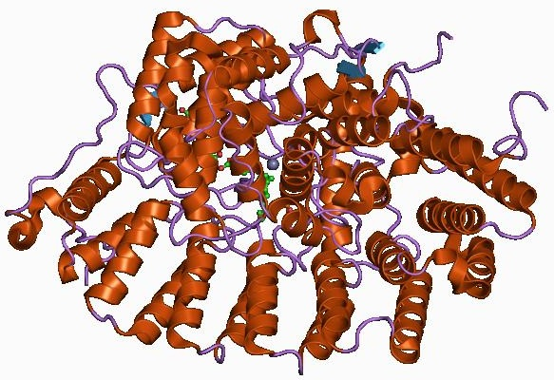
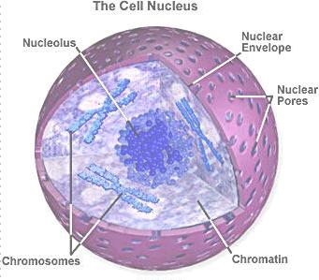
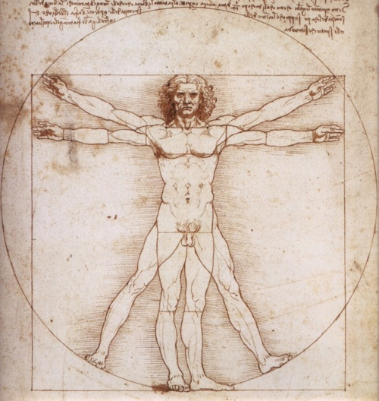
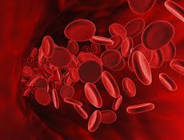
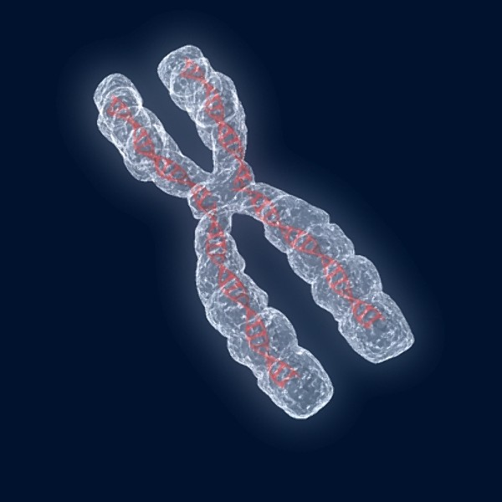
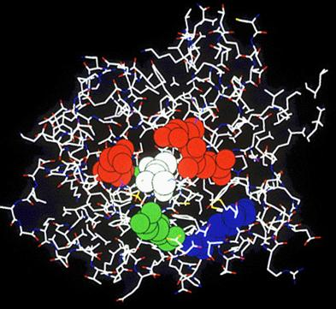
Introduction

Slide 6
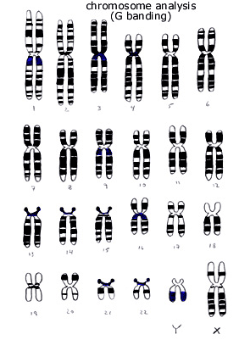
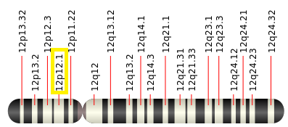
Chromosome 12
One of the 23 pairs of chromosomes in humans
Two copies of this chromosome
Represents between 4 and 4.5 percent of the total DNA in cells
Chromosome 12 likely contains between 1,000 and 1,300 genes
Among them, the KRAS gene

Slide 7
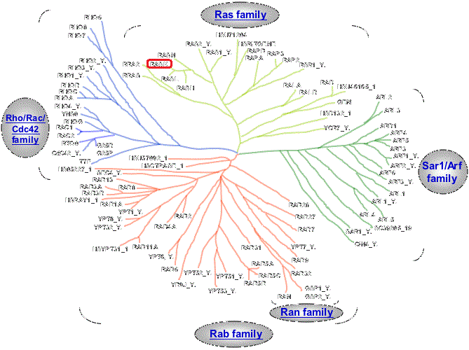
GTPase Proteins
Family of hydrolase enzymes
Bind and hydrolyze guanosine triphosphate (GTP)
Highly conserved G
domain
RAS belongs to
small GTPases

Slide 8


RAS
Ras is a family of related proteins.
’Rat sarcoma’
Members belong to small GTPase class of protein
Transmit signals within cells (cellular signal transduction)
When incoming signals ’switch on’ RAS RAS switches on other proteins these proteins turn on genes involved in cell growth
Mutations production of permanently activated Ras proteins
Overactive Ras signaling cancer.
The most common oncogene in human cancer mutations
found in 20-25% of all human tumors
up to 90% in certain types of cancer
(e.g. pancreatic cancer).
Subfamilies in human genome:
KRAS, NRAS and HRAS

Slide 9
KRAS
V-Ki-ras2 Kirsten rat sarcoma viral oncogene homolog
Performs an essential function in normal tissue signaling
Mutation of a KRAS gene development of many cancers
Usually tethered to cell membranes because of the presence of an isoprenyl group on its C-terminus

Slide 10
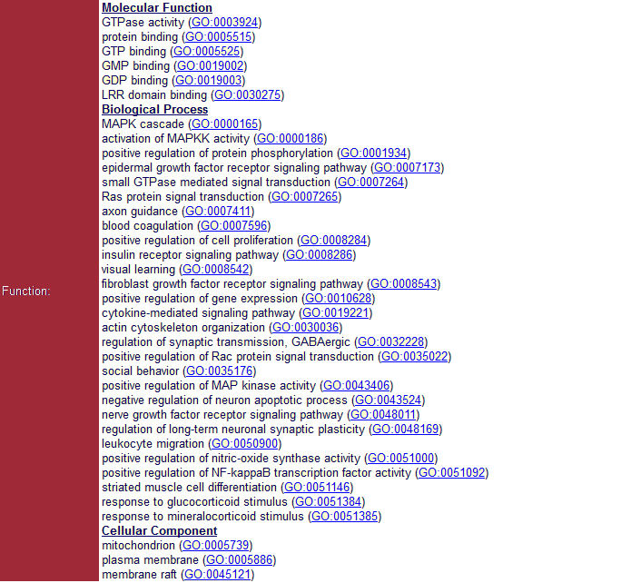
KRAS - Functionality

Slide 11
KRAS – Clinical Significance
A single amino acid substitution, and in particular a single nucleotide substitution, is responsible for an activating mutation
The first human oncogene found
Various malignancies:
lung adenocarcinoma (lung cancer)
mucinous adenoma (leukemias)
ductal carcinoma of the pancreas (pancreatic cancer)
colorectal carcinoma (colon cancer)
Noonan syndrome
Cardio-facio-cutaneous syndrome.
Colorectal cancer:
The chronological order of mutations is important
a primary KRAS mutation a self-limiting hyperplastic or borderline lesion
APC mutation followed by KRAS mutation cancer

Slide 12
Outline
Introduction
Sections:
KRAS Promoters
KRAS Isoforms
KRAS Conserved Regions
KRAS Phylogenetic Tree
KRAS Proteins
KRAS Transcription Factors
Bibliography

Slide 13
1. KRAS Promoters
Promoters
DNA regions initiate transcription of a particular gene.
Also, they are secure initial binding sites for
RNA polymerase
for proteins called Transcription Factors.
May not be part of the gene sequence

Slide 14
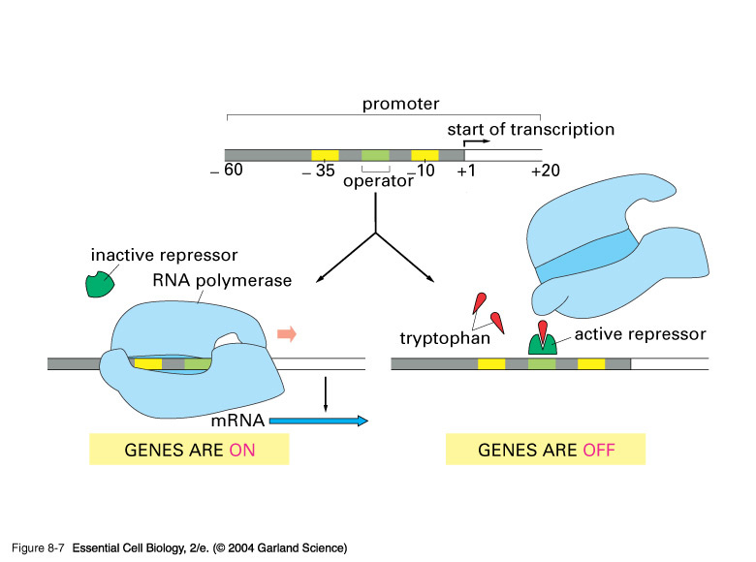

Slide 15
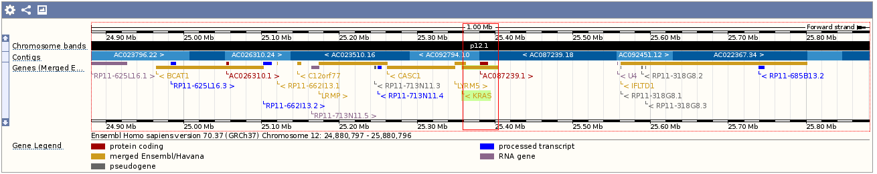
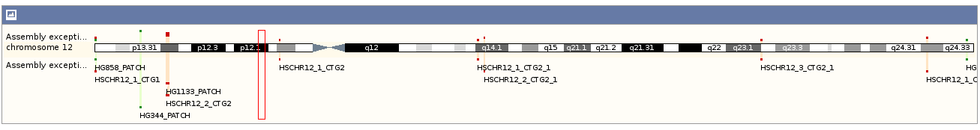
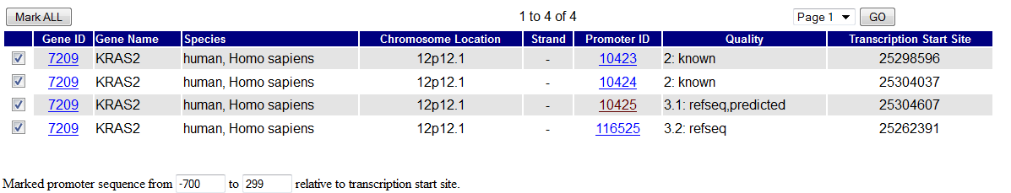
1. KRAS Promoters

Slide 16
1. KRAS as gene
General Information
Location: Chromosome 12 (25,357,723 - 25,403,870 ) reverse(-1) strand
Six exon positions
Exons: nucleotide sequence encoded for the final protein.
Can be or include untranslated regions (UTR)

Slide 17
2. KRAS Isoforms
Gene isoforms: m-RNAs derived from the same transcript but differ in:
transcription start sites (TSSs)
protein coding DNA sequences (CDSs)
untranslated regions (UTRs)
CDS Isoforms give rise to proteins with different functional properties.
The isoforms we founded are depicted at the next pictures:

Slide 18
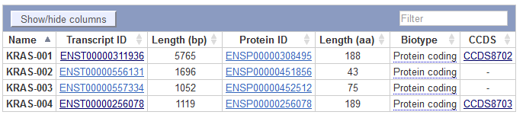
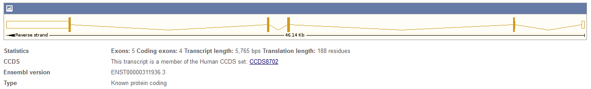
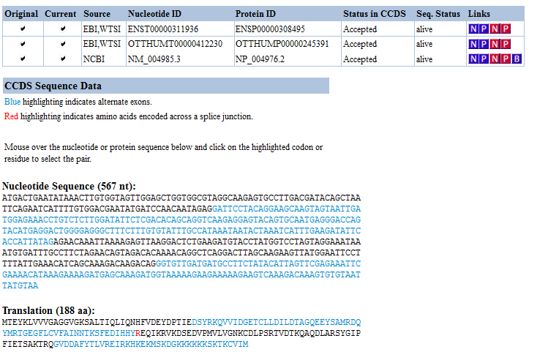

Slide 19
3. KRAS Conserved Areas
Conserved sequences:
Similar or identical DNA, RNA or Protein sequences between species (orthologous sequences) or
within different molecules produced by the same organism (paralogous sequences).
Since sequence information is transmitted from parents to progeny by genes, a conserved sequence implies that there is a conserved gene

Slide 20
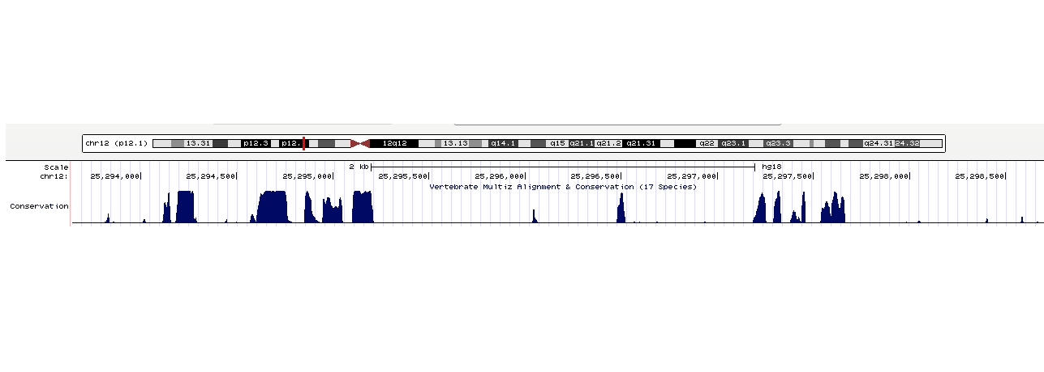
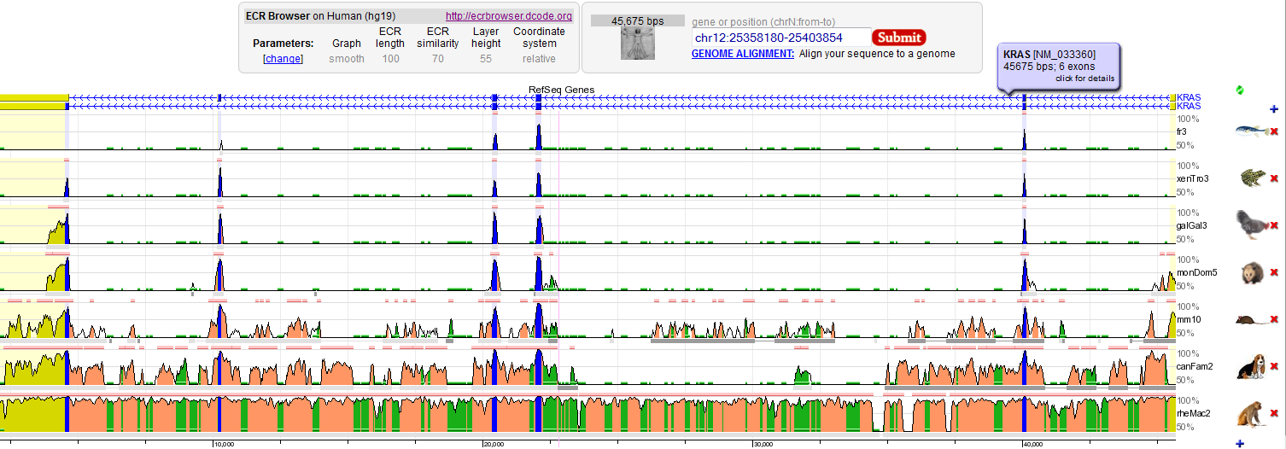
3. KRAS Conserved Areas

Slide 21
4. Phylogenetic Tree
Phylogenetic Tree: A diagram which depicts the lines of evolutionary descent of different species, organisms, or genes from a common ancestor
The further back up the phylogenetic tree a particular conserved sequence may occur the more highly conserved it is said to be.
The taxa joined together in the tree are implied to have descended from a common ancestor.

Slide 22
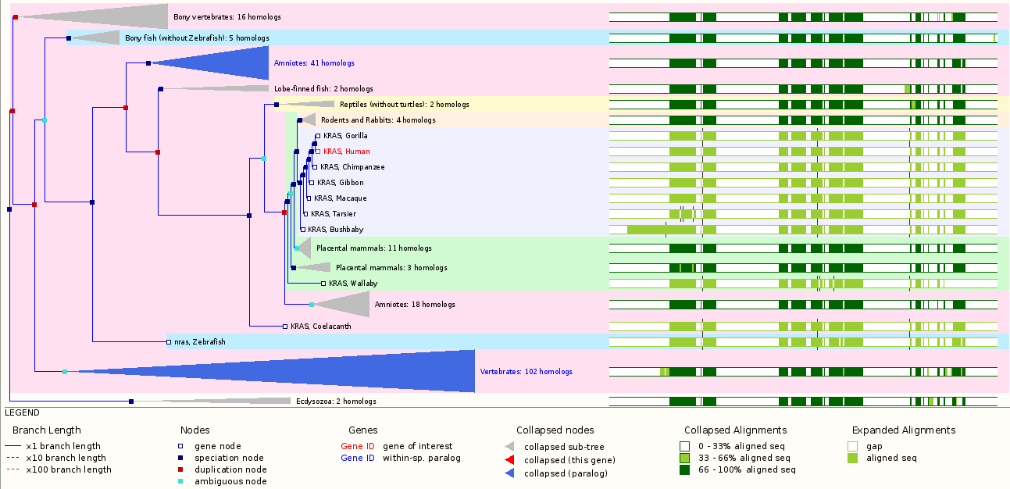
4. Phylogenetic Tree

Slide 23
5. Proteins
Kras is a GTPase protein, more specificly a G protein and plays a very important role in cell signaling.
First discovered in the early 1980s and changed the understanding of molecular biology of cancer.
The Ras mutation is responsible for the 20-30% of the development of all cancers,
The sequence length is 189 AA and the molecular weight is 21,565 Da
Kras plays an essential role in many signal transduction pathways, as a molecular on/off switcher.
GTP form-”on” state, GDP form-”off” state.
KRAS protein interaction with DNA, GTP binding sites:
Position 10-17, sequence GAGGVGKS
Position 57-61, sequence DTAGQ
Position 116-119, sequence NKCD

Slide 24
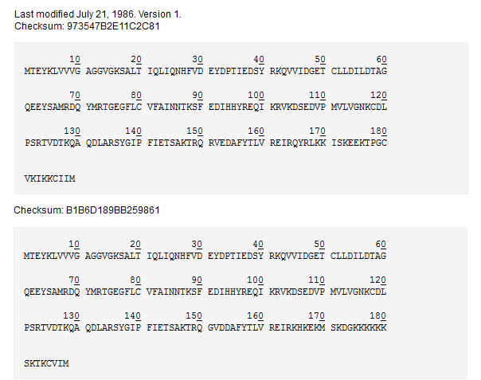
5. Proteins
Polypeptide sequences

Slide 25
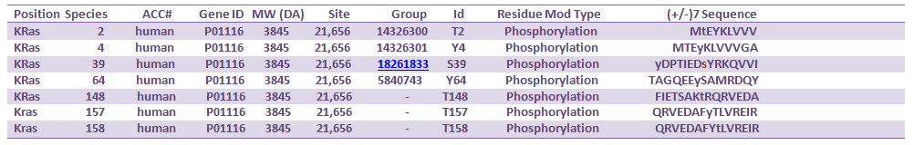
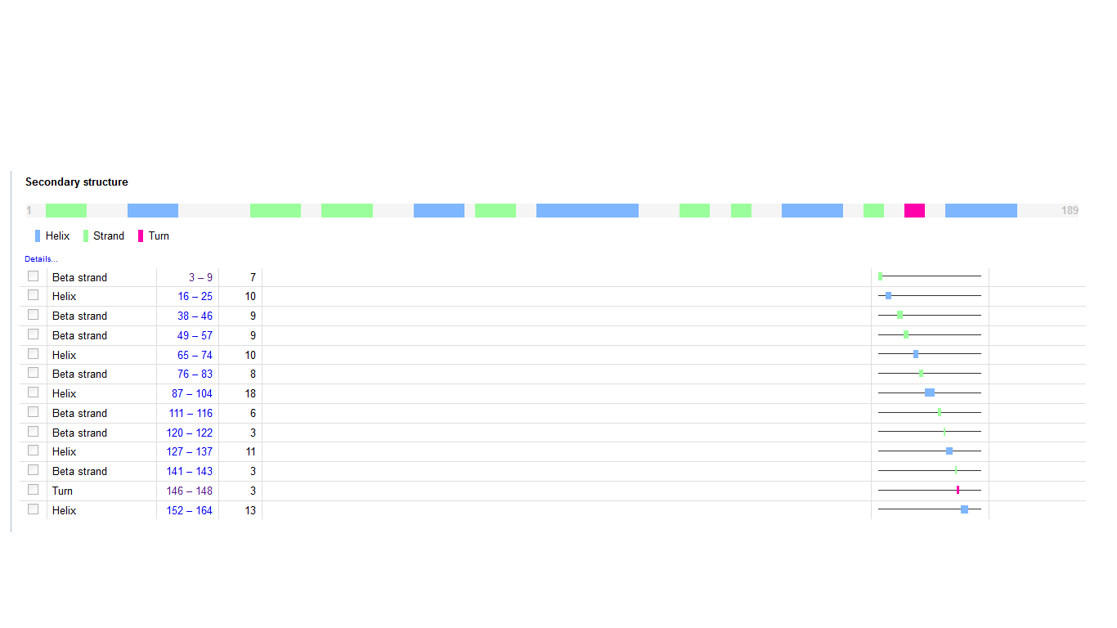
5. Protein - Phosphorytation
Phosphorytation
Secondary
Structure

Slide 26
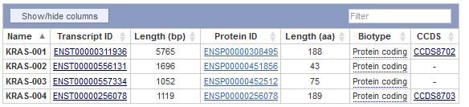
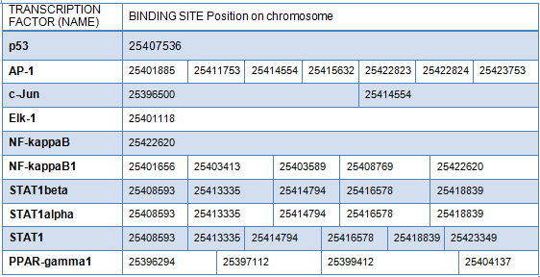
6. Transcription Factors

Slide 27
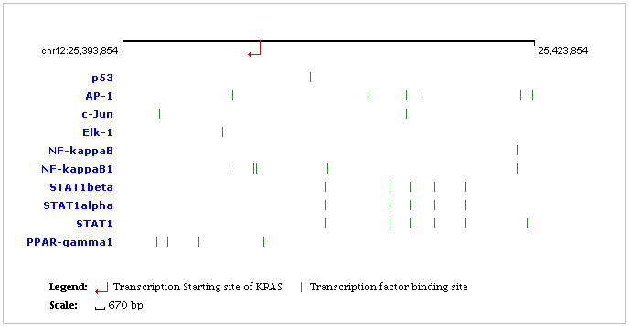
6. Transcription Factors – Binding Sites

Slide 28
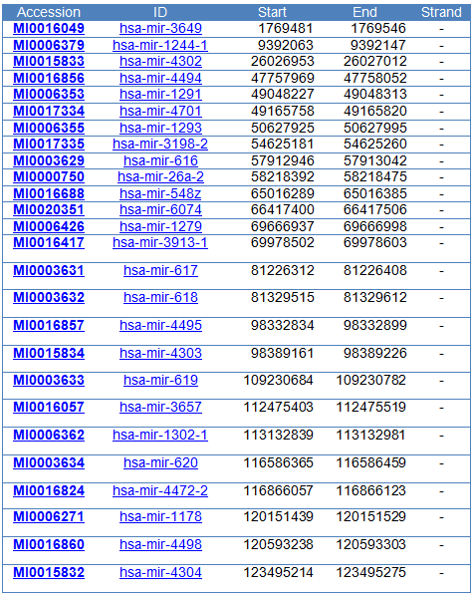
7. MiRNAs – Binding Sites

Slide 29
Bibliography
McGrath JP, Capon DJ, Smith DH, Chen EY, Seeburg PH, Goeddel DV, Levinson AD (1983). "Structure and organization of the human Kiras protooncogeneand a related processed pseudogene". Nature 304 (5926): 5016.doi:10.1038/304501a0. PMID 6308466.
Popescu NC, Amsbaugh SC, DiPaolo JA, Tronick SR, Aaronson SA, Swan DC (March 1985). "Chromosomal localization of three human ras genes by in situ molecular hybridization". Somat. Cell Mol. Genet. 11 (2): 14955. doi:10.1007/BF01534703. PMID 3856955.
Kranenburg O (November 2005). "The KRAS oncogene: past, present, and future". Biochim. Biophys. Acta 1756 (2): 812. doi:10.1016/j.bbcan.2005.10.001. PMID 16269215.
Neelan J. Marianayagam, Margaret Sunde, Jacqueline M. Matthews, The power of two: protein dimerization in biology, Trends in Biochemical Sciences, Volume 29, Issue 11, November 2004, Pages 618625, ISSN 09680004, 10.1016/j.tibs.2004.09.006. (http://www.sciencedirect.com/science/article/pii/S0968000404002348)

Slide 30
Thank you!
This presentation stands as a supplementary to the report written in the context of the ITMB, Biology assignment “KRAS Gene”, and it is recommended to be read alongside the report.
Aidonopoulos Orfeas
Begetis Nikolaos
Konstantopoulos Dimitrios

